Slide 1

Branch & Bound
Nitin Tiwari
Google Developer Expert – Machine Learning Software Engineer @ LTIMindtree

Slide 2
Branch & Bound
Branch and Bound algorithm is used for solving optimization problems where the goal is to find the best solution from a finite set of possible solutions.
Branching: The algorithm divides the problem into smaller subproblems, known as branches. These branches are explored individually to find potential solutions.
Bounding: During the exploration, the algorithm calculates a lower bound for each subproblem. If the lower bound of a subproblem is worse than the current upper bound, that branch can be pruned because it cannot lead to a better solution.
Backtracking: If a branch cannot be further subdivided (i.e., a solution or a leaf node is reached), the algorithm backtracks to the nearest ancestor node with remaining unexplored branches to continue the search.

Slide 3
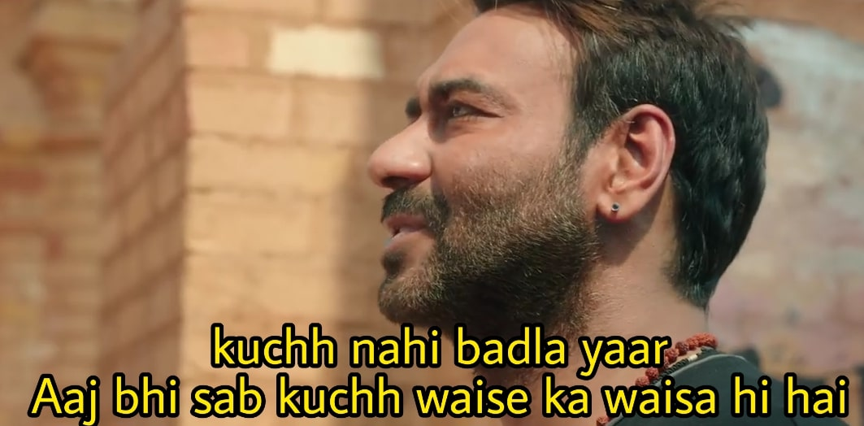

Slide 4
Initialize priority_queue
Initialize root node
Set initial upper_bound as infinity
Add root node to priority_queue
while priority_queue is not empty:
node = dequeue from priority_queue
if node is a partial solution and its cost < upper_bound:
Update upper_bound with node's cost
if node is not a leaf node:
Generate child nodes by branching on the next variable or subproblem
for each child node:
Calculate lower_bound for the child node
if lower_bound < upper_bound:
Add child node to priority_queue
End

Slide 5
Example
6
s
B
3
6
3
A
2
2
E
7
D
C
1
4
G
Starting Point: S
Destination: G
Goal: Reach G with minimum cost

Slide 6
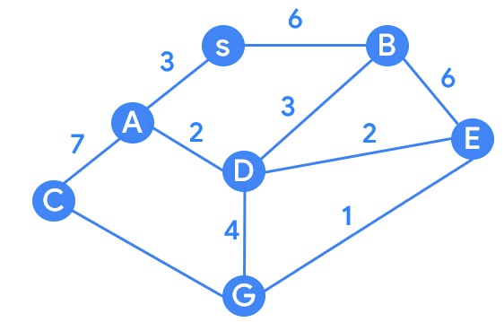
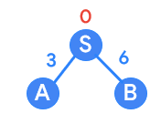
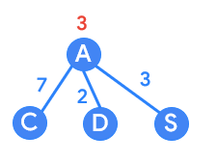
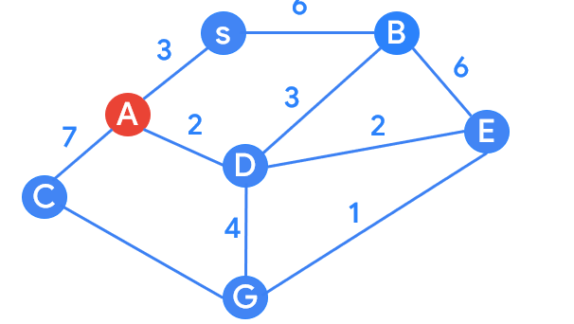
Step 1: Branch from S
S → A = 3
S → B = 6
Step 2: Branch/backtrack from A
A → C = 3 + 7 = 10
A → D = 3 + 2 = 5
A → S = 3 + 3 = 6

Slide 7
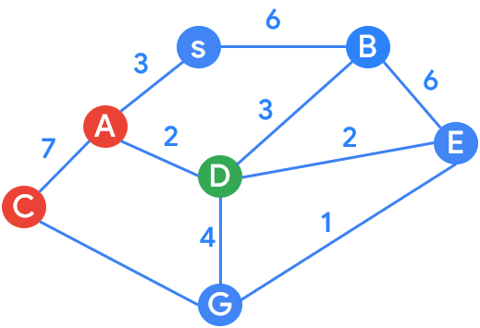
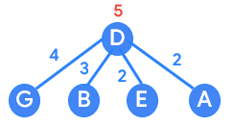
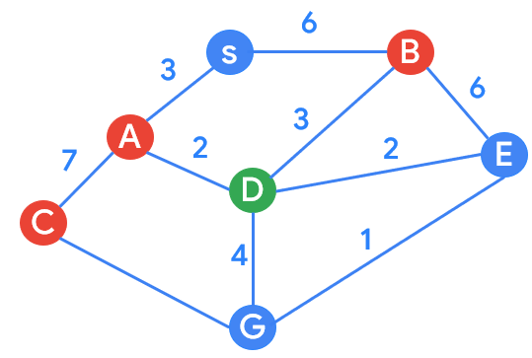
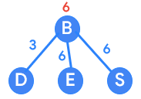
Step 3: Branch/backtrack from D
D → G = 5 + 4 = 9 (current solution)
D → B = 5 + 3 = 8
D → E = 5 +2 = 7
D → A = 5 + 2 = 7
Step 4: Branch from B [S → B]
B → D = 6 + 3 = 9 (prune)
B → E = 6 + 6 = 12 (prune)
B → S = 5 + 2 = 12 (prune)

Slide 8
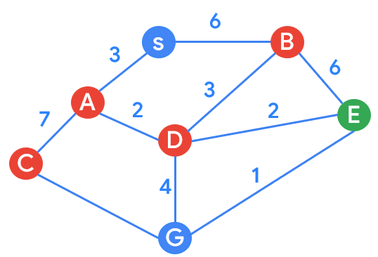
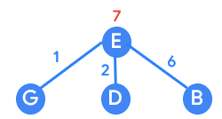
Step 5: Branch from E [S → A → D → E]
E → G = 7 + 1 = 8 (current best solution)
E → D = 7 + 2 = 9 (prune)
E → B = 7 + 6 = 13 (prune)
All solutions found:
S → A → D → G = 9
S → A → D → E → G = 8 (best solution)

Slide 9





Where can I express myself?
Online competitions: Hackathons, coding competitions, events, fests, etc.
Academics: Set realistic goals.
Get a strong hold on subjects like DBMS, Data Structures, and OS.
Get your basics clear.
Practice regularly.
Be consistent.

Slide 10


Where can I express myself?
Engage with communities: GDG, GDSCs, TFUGs, etc.
Work on projects: Create some good projects, and push them on your GitHub profile.
Share your work: Your public profile is your identity. Don’t hesitate to share your skills on LinkedIn, and other social media platforms.

Slide 11


Slide 12




Thank You.
medium.com/@tiwarinitin1999
twitter.com/@NSTiwari21
github.com/NSTiwari

